Slide 1


3
Exponential and
Logarithmic Functions
Copyright © Cengage Learning. All rights reserved.

Slide 2

3.1
EXPONENTIAL FUNCTIONS AND THEIR GRAPHS
Copyright © Cengage Learning. All rights reserved.

Slide 3
What You Should Learn
Recognize and evaluate exponential functions
with base a.
Graph exponential functions and use the
One-to-One Property.
Recognize, evaluate, and graph exponential
functions with base e.
Use exponential functions to model and solve
real-life problems.

Slide 4
Exponential Functions

Slide 5
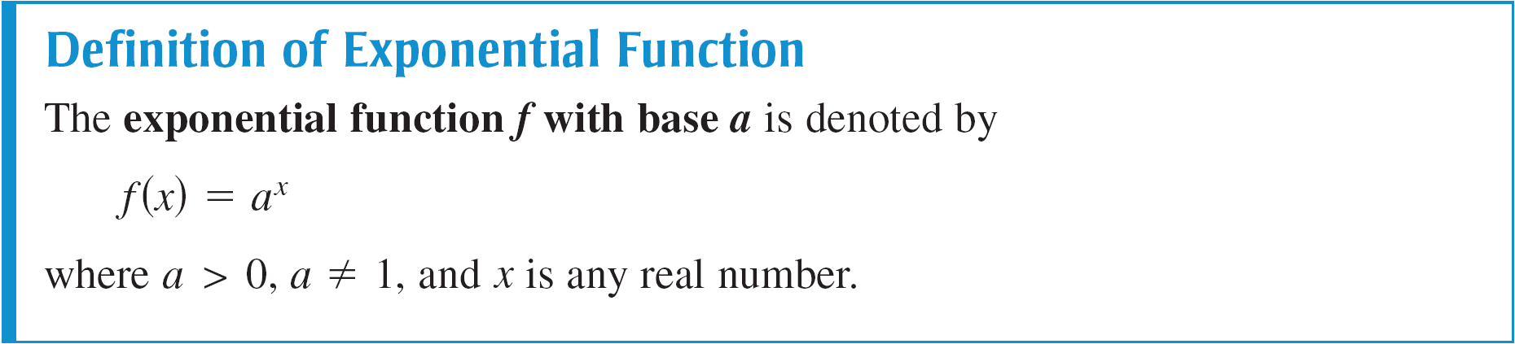
Exponential Functions
So far, this text has dealt mainly with algebraic functions, which include polynomial functions and rational functions.
In this chapter, you will study two types of nonalgebraic functions–exponential functions and logarithmic functions. These functions are examples of transcendental functions.

Slide 6
Exponential Functions
The base a = 1 is excluded because it yields f (x) = 1^{x} = 1. This is a constant function, not an exponential function.
You have evaluated a^{x} for integer and rational values of x.
For example, you know that 4³ = 64 and 4^{1/2} = 2.
However, to evaluate 4^{x} for any real number x, you need to interpret forms with irrational exponents.

Slide 7


Exponential Functions
For the purposes of this text, it is sufficient to think of
(where ≈ 1.41421356)
as the number that has the successively closer approximations
a^{1.4}, a^{1.41}, a^{1.414}, a^{1.4142}, a^{1.41421}, . . . .

Slide 8

Example 1 – Evaluating Exponential Functions
Use a calculator to evaluate each function at the indicated value of x.
Function Value
a. f (x) = 2^{x} x = –3.1
b. f (x) = 2^{–x} x = π
c. f (x) = 0.6^{x} x =

Slide 9




Example 1 – Solution
Function Value Graphing Calculator Keystrokes Display
a. f (–3.1) = 2^{–3.1} 0.1166291
b. f (π) = 2^{–π} 0.1133147
c. f = 0.6^{3/2} 0.4647580

Slide 10
Graphs of Exponential Functions

Slide 11
Example 2 – Graphs of y = a^{x}
In the same coordinate plane, sketch the graph of each function.
a. f (x) = 2^{x}
b. g(x) = 4^{x}

Slide 12
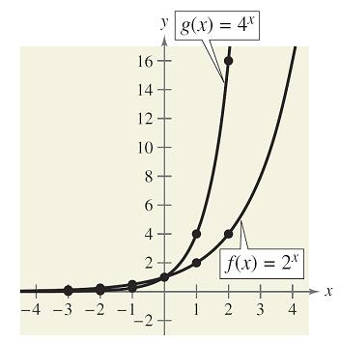
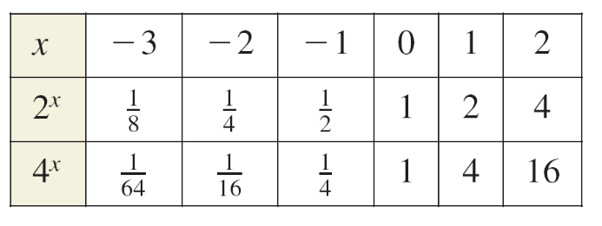
Example 2 – Solution
The table below lists some values for each function, and Figure 3.1 shows the graphs of the two functions.
Note that both graphs are increasing. Moreover, the graph of g(x) = 4^{x} is increasing more rapidly than the graph of
f (x) = 2^{x}.
Figure 3.1

Slide 13
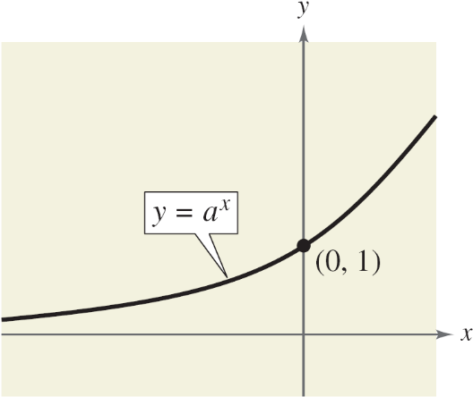

Graphs of Exponential Functions
The basic characteristics of exponential functions y = a^{x} and y = a^{–x} are summarized in Figures 3.3 and 3.4.
Graph of y = a^{x}, a > 1
Domain: ( , )
Range: (0, )
y-intercept: (0, 1)
Increasing
x-axis is a horizontal asymptote (a^{x}→ 0, as x→ ).
Continuous
Figure 3.3

Slide 14
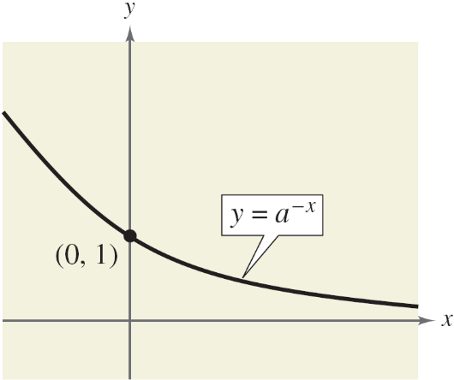
Graphs of Exponential Functions
Graph of y = a^{–x}, a > 1
Domain: ( , )
Range: (0, )
y-intercept: (0, 1)
Decreasing
x-axis is a horizontal asymptote (a^{–x} → 0, as x→ ).
Continuous
From Figures 3.3 and 3.4, you can see that the graph of an exponential function is always increasing or always decreasing.
Figure 3.4

Slide 15
Graphs of Exponential Functions
As a result, the graphs pass the Horizontal Line Test, and therefore the functions are one-to-one functions.
You can use the following One-to-One Property to solve simple exponential equations.
For a > 0 and a ≠ 1, a^{x} = a^{y} if and only if x = y.
One-to-One Property

Slide 16
The Natural Base e

Slide 17
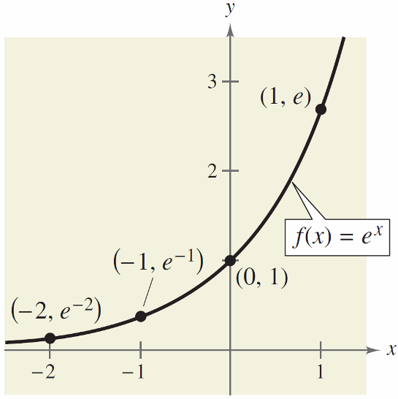
The Natural Base e
In many applications, the most convenient choice for a base is the irrational number
e ≈ 2.718281828 . . . .
This number is called the natural base.
The function given by f (x) = e^{x} is
called the natural exponential
function. Its graph is shown in
Figure 3.9.
Figure 3.9

Slide 18
The Natural Base e
Be sure you see that for the exponential function
f (x) = e^{x}, e is the constant 2.718281828 . . . , whereas x
is the variable.

Slide 19
Example 6 – Evaluating the Natural Exponential Function
Use a calculator to evaluate the function given by
f (x) = e^{x} at each indicated value of x.
a. x = –2
b. x = –1
c. x = 0.25
d. x = –0.3

Slide 20




Example 6 – Solution
Function Value Graphing Calculator Keystrokes Display
a. f (–2) = e^{–2} 0.1353353
b. f (–1) = e^{–1} 0.3678794
c. f (0.25) = e^{0.25} 1.2840254
d. f (–0.3) = e^{–0.3} 0.7408182

Slide 21
Applications

Slide 22
Applications
One of the most familiar examples of exponential growth is an investment earning continuously compounded interest.
Using exponential functions, you can develop a formula for interest compounded n times per year and show how it leads to continuous compounding.
Suppose a principal P is invested at an annual interest rate r, compounded once per year. If the interest is added to the principal at the end of the year, the new balance P₁ is
P₁ = P + Pr
= P(1 + r).

Slide 23
Applications
This pattern of multiplying the previous principal by 1 + r is then repeated each successive year, as shown below.
Year Balance After Each Compounding
0 P = P
1 P₁ = P(1 + r)
2 P₂ = P₁(1 + r) = P(1 + r)(1 + r) = P(1 + r)²
3 P₃ = P₂(1 + r) = P(1 + r)²(1 + r) = P(1 + r)³
t P_{t} = P(1 + r)^{t}
…
…

Slide 24
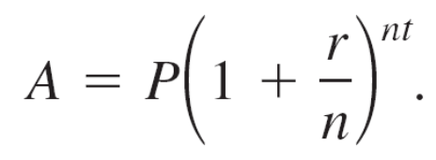
Applications
To accommodate more frequent (quarterly, monthly, or daily) compounding of interest, let n be the number of compoundings per year and let t be the number of years.
Then the rate per compounding is r/n and the account balance after t years is
If you let the number of compoundings n increase without bound, the process approaches what is called continuous compounding.
Amount (balance) with n compoundings
per year

Slide 25
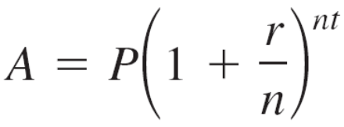
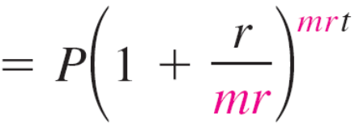
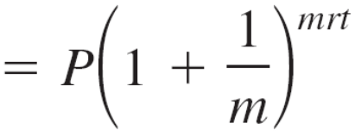
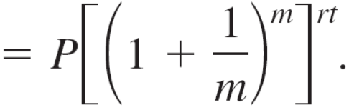
Applications
In the formula for n compoundings per year, let m = n/r. This produces
Amount with n compoundings per year
Substitute mr for n.
Simplify.
Property of exponents

Slide 26
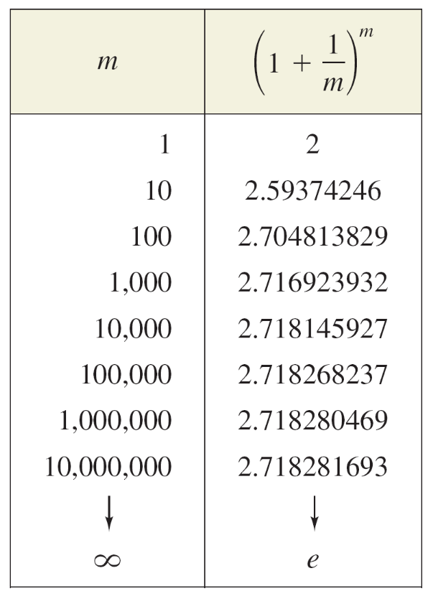
Applications
As m increases without bound, the table below shows that
[1 + (1/m)]^{m}→e as m → .
From this, you can conclude that
the formula for continuous
compounding is
A = Pe^{rt}.
Substitute e for (1 + 1/m)^{m}.

Slide 27
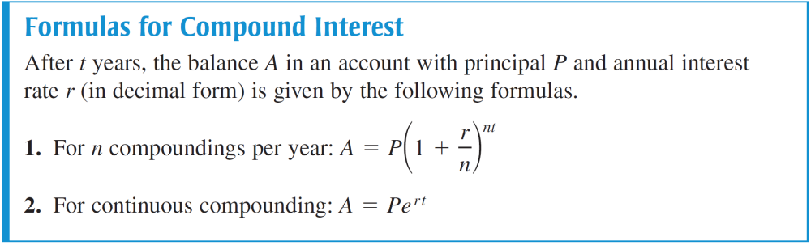
Applications

Slide 28
Example 8 – Compound Interest
A total of $12,000 is invested at an annual interest rate of 9%. Find the balance after 5 years if it is compounded
a. quarterly.
b. monthly.
c. continuously.

Slide 29
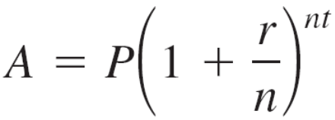


Example 8(a) – Solution
For quarterly compounding, you have n = 4. So, in 5 years at 9%, the balance is
Formula for compound interest
Substitute for P, r, n, and t.
Use a calculator.

Slide 30
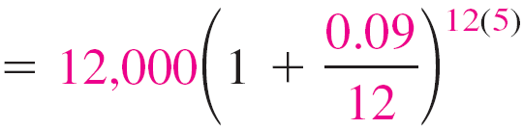

Example 8(b) – Solution
cont’d
For monthly compounding, you have n = 12. So, in 5 years at 9%, the balance is
Formula for compound interest
Substitute for P, r, n, and t.
Use a calculator.

Slide 31
Example 8(c) – Solution
cont’d
For continuous compounding, the balance is
A = Pe^{rt}
= 12,000e^{0.09(5)}
≈ $18,819.75.
Formula for continuous compounding
Substitute for P, r, and t.
Use a calculator.

